Slide 1
3. Ground support equipment
The GSE can be divided into the following two types:
Non-powered equipment
Powered equipment
Powered equipment 有动力装置的设备
Non-powered equipment 无动力装置的设备

Slide 2

3. Ground support equipment
Non-powered equipment
Non-powered equipment mainly include the three types:
Dolly
Wheel chocks
Aircraft Tripod Jack
Dolly 挂车
Wheel chocks 止轮块
Aircraft Tripod Jack 三脚架千斤顶

Slide 3
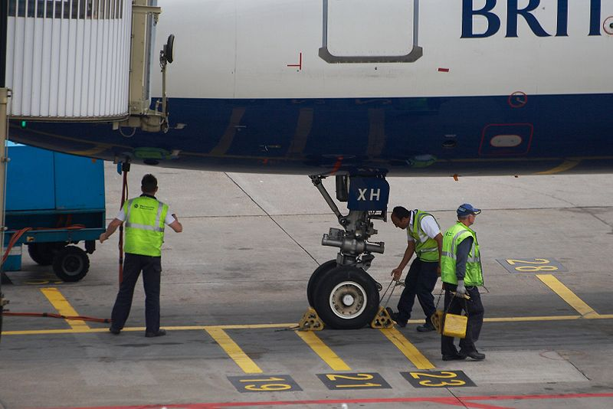
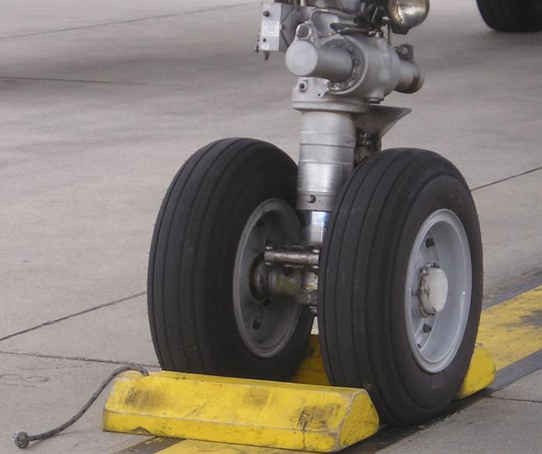
3. Ground support equipment
Wheel chocks
Wheel chocks (or chocks) are wedges of sturdy material placed closely against a vehicle's wheels to prevent accidental movement. Chocks are placed for safety in addition to setting the brakes.
They are made out of hard wood or hard rubber.
Wheel chocks 止轮块
hard rubber 硬橡胶；

Slide 4
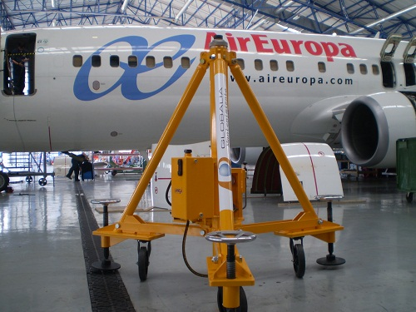
3. Ground support equipment
Aircraft Tripod Jack
They are used to support a parked aircraft to prevent their tail from drooping or even falling to the ground.
Aircraft Tripod Jack 三脚架千斤顶

Slide 5
3. Ground support equipment
Powered equipment
Powered equipment mainly include the following types:
Refuelers
Tugs or towing tractor
Ground Power Unit (GPU)
Airport bus
Container loader
Potable water trucks
Lavatory service vehicles
Belt loaders
Passenger boarding steps/ramps
De-icing vehicles

Slide 6

3. Ground support equipment
Refuelers
Aircraft refuelers can be either a self-contained fuel truck, or a hydrant truck or cart.
Fuel trucks are self-contained, typically containing up to 10,000 US gallons of fuel and have their own pumps, filters, hoses, and other equipment.
A hydrant cart or truck hooks into a central pipeline network and provides fuel to the aircraft.
refueler 加燃料器
self-contained adj. 独立的；设备齐全的；
Fuel truck 油罐车
hydrant cart 油泵车

Slide 7
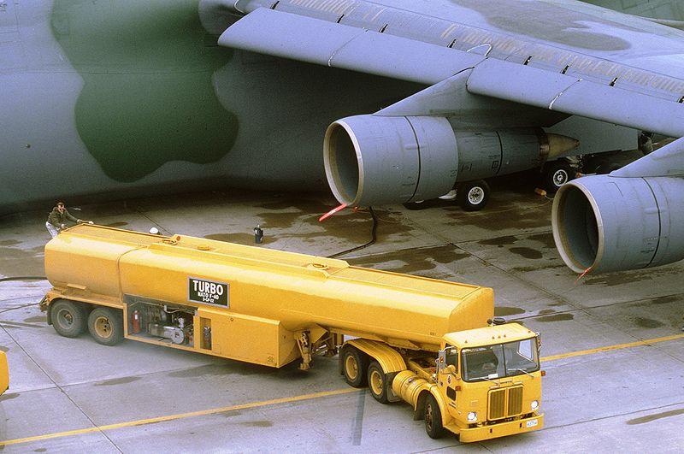
3. Ground support equipment
Refuelers
fuel truck
Fuel truck 油罐车

Slide 8
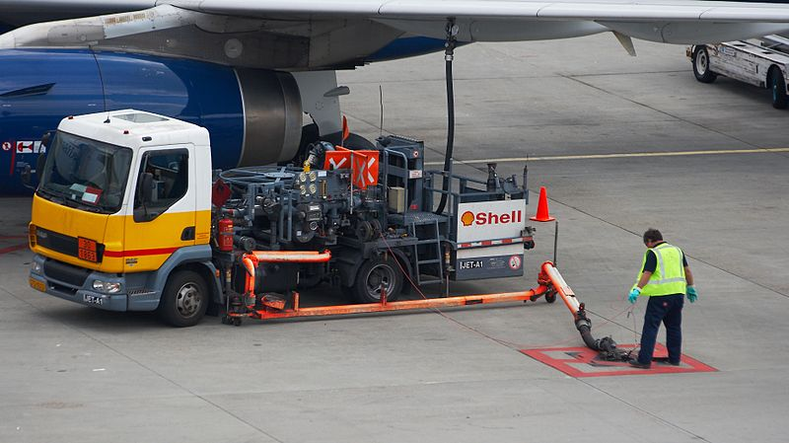
hydrant cart
3. Ground support equipment
Refuelers
hydrant cart 油泵车

Slide 9
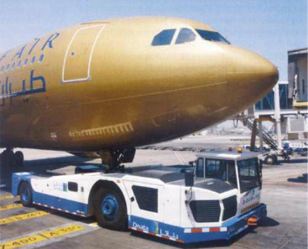
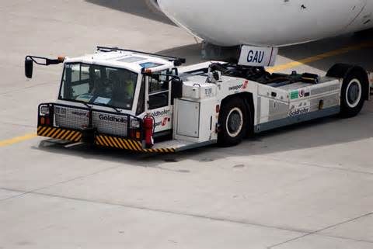
3. Ground support equipment
Tugs or towing tractor
Tugs or towing tractor at an airport are used to move all equipment that can not move itself.
They represent the essential part of ground support services.
Tug 拖车

Slide 10
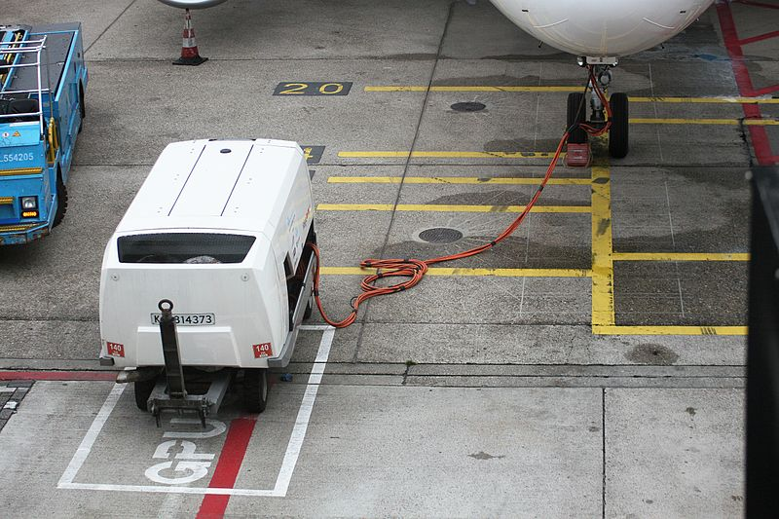
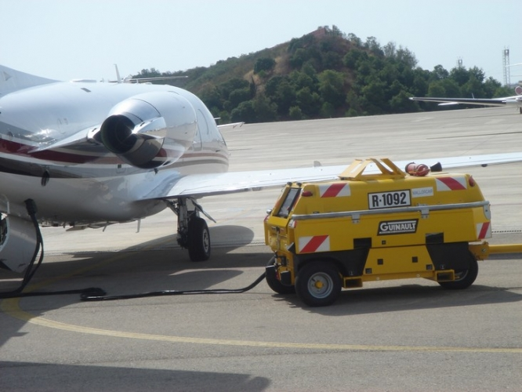
3. Ground support equipment
Ground Power Unit (GPU)
A ground power unit (GPU) is a vehicle capable of supplying power to aircraft parked on the ground.
Ground power unit that needs towing
Ground Power Unit (GPU) 地面电源车， 地面发电机；

Slide 11
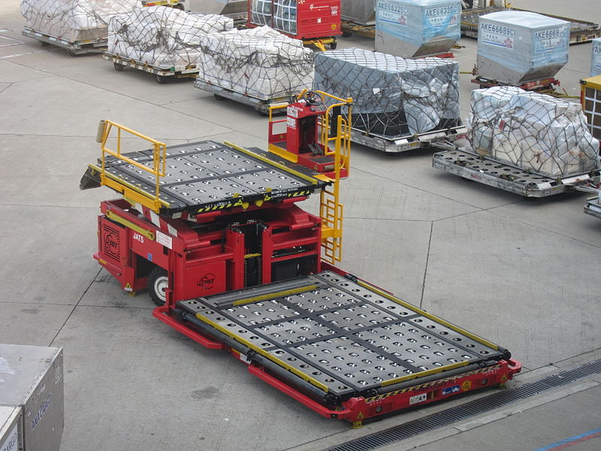
3. Ground support equipment
container loader
Container loaders, also known as cargo loaders or "K loaders", are used for the loading and unloading of containers and pallets into and out of aircraft. The loader has two platforms which raise and descend independently. The containers or palettes on the loader are moved with the help of built-in rollers or wheels. There are different container and pallet loaders.
container loader
container loader 装箱机

Slide 12
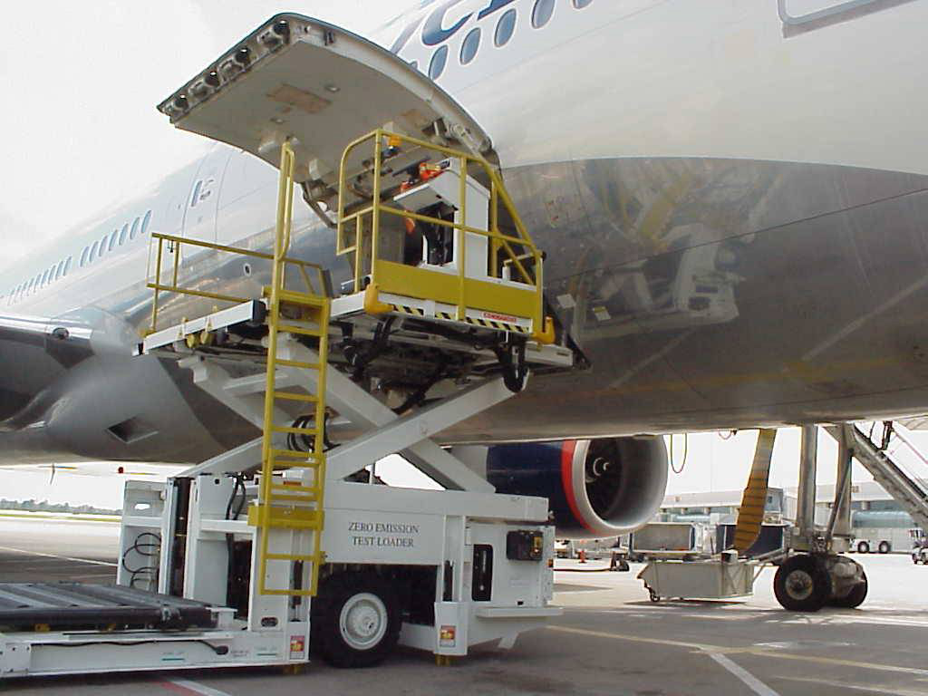
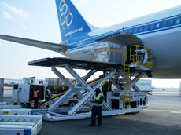
3. Ground support equipment
container loader
container loader 装箱机

Slide 13
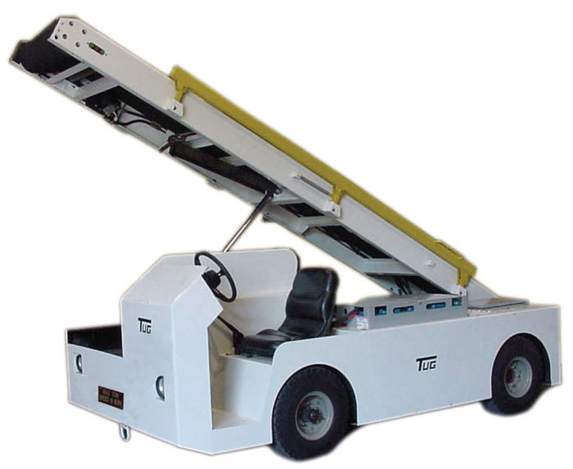
3. Ground support equipment
Belt Loader
Belt loaders are vehicles with conveyor belts for unloading and loading of baggage and cargo on aircraft.
A belt loader is positioned at the door sill of an aircraft hold (baggage compartment) for the operation.
Belt loaders 皮带式装载机

Slide 14
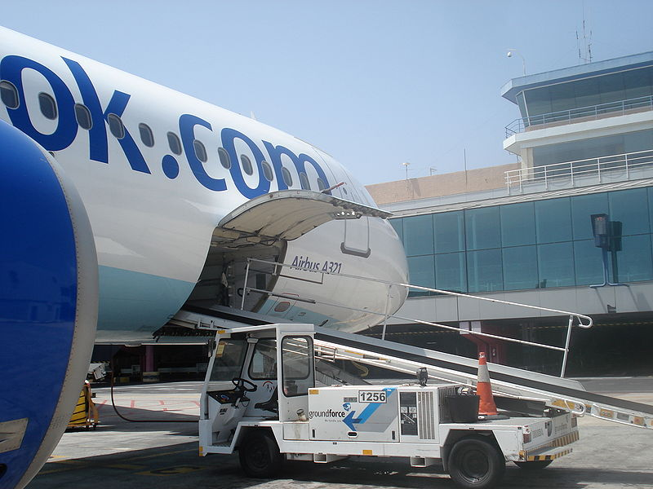
3. Ground support equipment
Belt Loader
Belt loaders 皮带式装载机

Slide 15
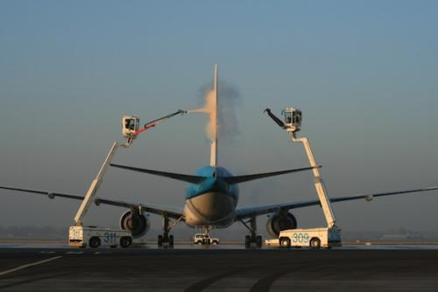
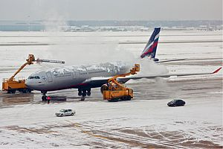
3. Ground support equipment
De-icing vehicles
The procedure of de-icing, protection from fluids freezing up on aircraft, is done from special vehicles.
These vehicles have booms, like a cherry picker, to allow easy access to the entire aircraft.
De-icing vehicle 除冰车辆
Boom吊杆
cherry picker 动臂装卸机；车载式吊车；

